Slide 1
Managing Cash & Investments
Team Kowalski Analytics
Nawaz NM
S. Niranjan

Slide 2
Index
QA
QC
QD
QE

Slide 3
Executive Summary
87.5% of funds are required within a period of 1 year implying liquidity requirements are extremely high.
Liquid MFs, Credit Risk MFs, & Overnight MFs constitute 56% of total allocations.
Custom-tailored performance benchmarks that reflect the strategy and methodology of the individual investment manager can separate the results of investment style/methodology from those of investment decision-making.
Artificial Intelligence has already creeped into the Investment Management ecosystem as hence one must adopt practices to stay competitive
Alternative investments such as Venture Capitalism, Private equity and intellectual property should be looked into as they are on the rise

Slide 4
QA. Portfolio Allocation
Asset Allocation decision was based on the Markowitz Model for Multiple Assets, which provides a framework for Portfolio construction allowing for maximizing potential returns while minimizing risk.
The objective was to maximize Sharpe Ratio while adhering to Investment Policy Limits.
Funds to required within 3 Months = Rs. 1,250 Cr. (62.5% of total funds)
Funds Required within 1 Year = Rs. 1,750 Cr. (87.5% of total funds)
Funds Required after 1 Year = Rs. 250 Cr. (12.5% of total funds)

Slide 5
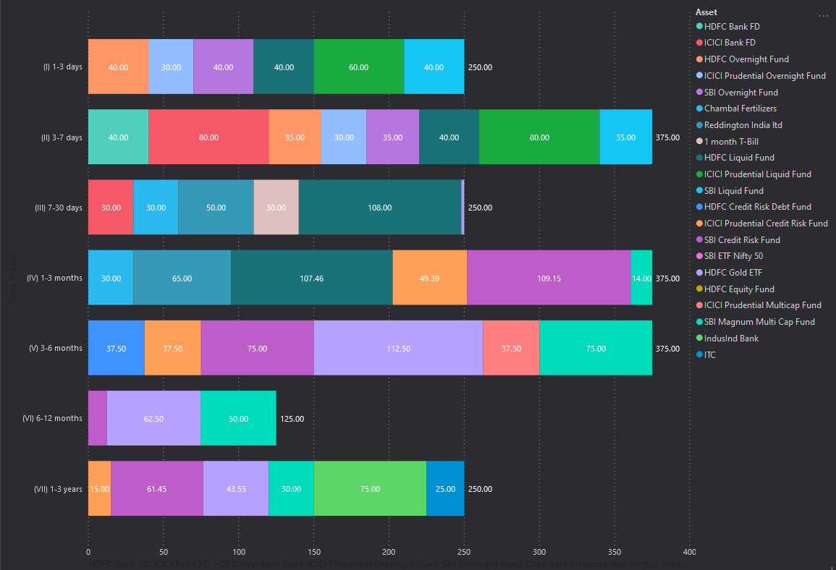
Asset Allocation Breakdown (in Cr.) based on Investment Time Frame

Slide 6
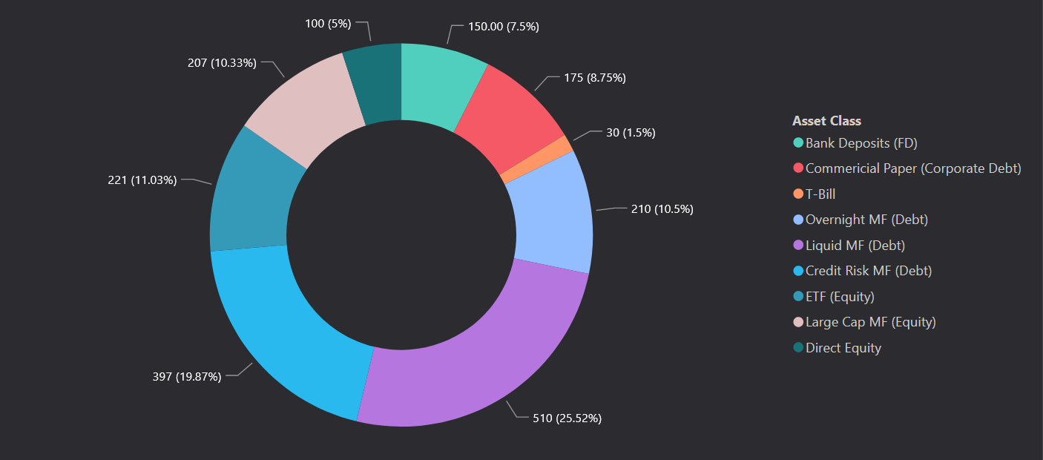
Total Allocation (in Cr.) in various Asset Classes

Slide 7
QC. (b) Benchmarking Methodology
Primary Aim
Custom-tailored performance benchmarks that reflect the strategy and methodology of the individual investment manager
Can separate the results of investment style/methodology from those of investment decision-making.
Combined with performance attribution analysis it can help examine effects of market timing and sector, industry and security selection on the portfolio.
Basic benchmark portfolio - compare the investment portfolio to a portfolio consisting of the benchmarks of the funds and schemes that one invests in.

Slide 8
QC. (b) Benchmarking Methodology
Secondary Aim
Review and select better/appropriate benchmarks for each asset in the portfolio
If the average is more than the benchmark consistently, then take the average as the benchmark
Custom benchmarking can be done by each the company itself based on targets and standards set by the company.
Custom Benchmarking for mutual funds, equities, bonds etc., are also made available by 3rd party research groups.

Slide 9
QD. Technology & Software tools
Machine Learning – Helps in eliminating cognitive biases in investment decisions
Blockchain – Increases process efficiency, transparency and also lowers costs
API Ecosystems
Artificial Intelligence in improving front, middle, and back office efficiency
- Operations intelligence: using machine learning to automate functions
- Powering risk performance: AI-based algorithms and machine learning to monitor for suspicious transactions, and trigger response protocols
- Reporting and servicing: generating reporting for clients, portfolio and risk commentary, and marketing material using natural language processing
Artificial Intelligence for portfolio management
- Automated insights: earnings transcripts can be read automatically by the system to assess management sentiment.
- Relationship mapping: nonintuitive relationships between market indicators and the securities can be identified.

Slide 10

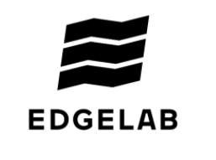


INFORMATION AND ANALYTICS
Refinitiv EIKON brings together the industry’s best data and most powerful research and analysis tools to help you pursue profitable investment management opportunities with conviction.
EDGELAB is a software with multi-asset class risk analytics and portfolio construction capabilities. Improving the whole investment process - from generating tailored investment proposals and reports to on-going monitoring and automated rebalancing
PORTFOLIO MANAGEMENT
Aladdin (Asset, Liability, Debt and Derivative Investment Network) is an electronic system by BlackRock Solutions, the risk management division of the largest investment management corporation, BlackRock, Inc.
Bloomberg's Treasury and Risk Management (TRM) solutions build on the company's core strength: leveraging technology to allow customers to access, integrate, distribute and manage data and information across organizations more efficiently and effectively.

Slide 11
QE. (a) Choice of investment
As Orion Technologies is an Indian multinational conglomerate and provides information technology and business process services,
Investing in Venture Capital, Intellectual Properties and Private Equity might be very useful as it can potentially benefit the company in terms of bringing new technologies and also diversifying its own products.
Venture Capital: An alternative investment to regular ones is venture capital (VC), or pledging an investment to a smaller company that has long-term potential in exchange for equity. Selling the company’s share or acquiring the company for our own needs may prove very useful.
Intellectual Property: Intellectual property is a unique alternative investment because its value can increase indefinitely.
Private Equity: The purpose of private equity is to invest growth capital into new businesses and help them restructure to accelerate growth, the business is restructured to maximize profitability, and then put on the market to be sold.

Slide 12
QE. (b) Policy Parameters
The minimum allocation for Liquid Funds can be reduced from 20% to 15% and the differential can be invested into the given Commercial Papers (all having a credit rating of A1+ in the short term) have historical returns in the shorter tenors to be greater (except Godrej CP) than that offered by the Liquid Funds. The liquidity requirements will still be met based on CP maturity and in doing so, our returns can be improved upon.
The minimum allocation for ETFs & Large Cap MFs can be reduced from 10% to 7.5% each, the reasoning behind it is that while their historical annualized rates of return are great, the present day volatility causes the risk to increase considerably, especially for shorter durations of time. The freed up funds can either be allocated to long term bonds or invested in carefully selected undervalued equities for a longer duration, for the shorter tenors, the freed up funds could be invested into Credit Risk MFs who have shown to have a considerably lower variance based on the past 5 year historical data.

Slide 13
QE. (c) Strategy for investment
Alternative Investments should be looked into as they are on the rise
Diversified portfolios with the right spread of alternative asset classes and fixed income assets will be better equipped to weather sudden economic risks.
To ensure balanced exposure and better yields, firms are opting for emerging market bonds from Asia, Latin America, Eastern Europe, and Africa.
Fixed income asset classes that are subject to floating rates and offer a degree of diversification that cannot be achieved through conventional mix of bonds and equities should be preferred.
Smart beta exchange-traded funds (ETFs) that focus on reducing beta while driving alpha for risk averse investments should be looked into.
Socially responsible investments that generate social and environmental impact through investments should be looked into as a manner of investment and CSR.

Slide 14
Thank You

